Slide 1
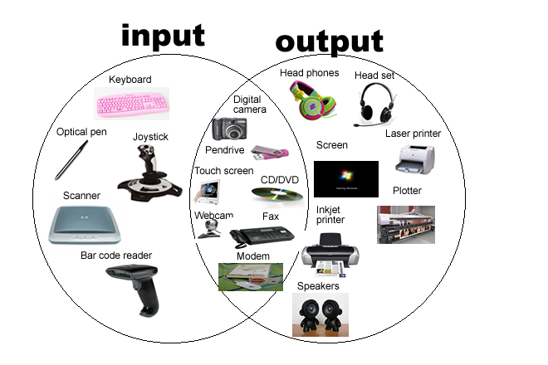
SEN111 CSE111 ICT
Input / Output Devices
Lecture 4 (Week 2)
By Mr. Faheem Shaukat
faheem@iqraisb.edu.pk
Github.com/faheemshaukat

Slide 2
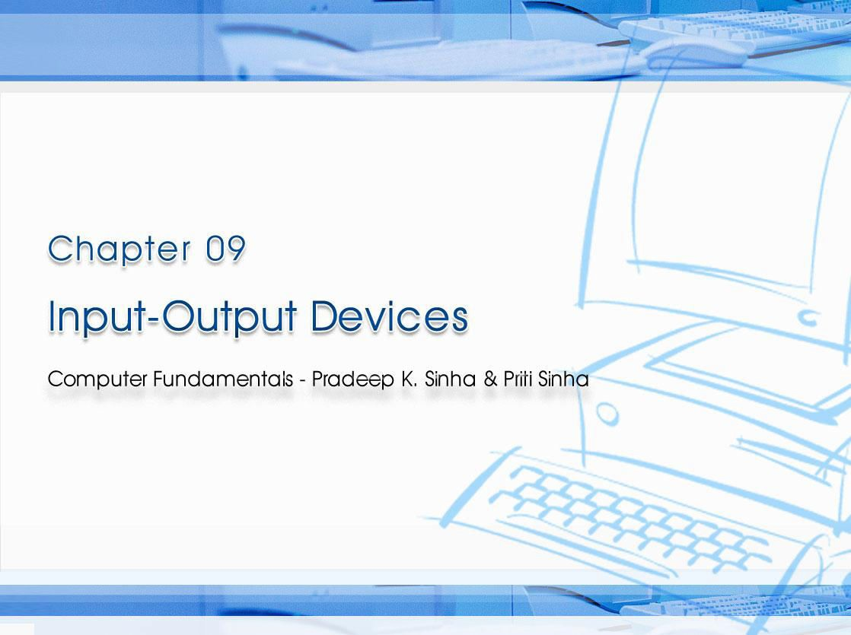
CCoommppuutterer FFununddaammenenttaallss:: PPrradadeeeepp KK.. SSiinhnhaa && PPrriititi SSiinhanha
Ref Page Chapter 9: Input-Output Devices Slide 1/58

Slide 3

Computer Fundamentals: Pradeep K. Sinha & Priti Sinha
Learning Obj ect ives
I n this chapter you w ill learn about:
§ Input/Output (I/O) devices
§ Commonly used input devices
§ Commonly used output devices
§ Other concepts related to I/O devices
148

Slide 4
I / O Devices
Computer Fundamentals: Pradeep K. Sinha & Priti Sinha
§ Provide means of communication between a computer and outer world
§ Also known as peripheral devices because they surround the CPU and memory of a computer system
§ Input devices are used to enter data from the outside world into primary storage
§ Output devices supply results of processing from primary storage to users
148

Slide 5
Computer Fundamentals: Pradeep K. Sinha & Priti Sinha
Role of I / O Devices
Input data from external world
Input Devices
CPU
and Memory
Output Devices
Results of processing in human acceptable form
Input data coded in internal form
Processed data in internal form
148

Slide 6
Computer Fundamentals: Pradeep K. Sinha & Priti Sinha
Com m only Used I nput Devices
§ Keyboard devices
§ Point-and-draw devices
§ Data scanning devices (1/2 Self Reading)
§ Digitizer
§ Electronic cards based devices
§ Speech recognition devices (Self Reading)
§ Vision based devices (Self Reading)
149

Slide 7
Computer Fundamentals: Pradeep K. Sinha & Priti Sinha
Keyboard Devices
§ Allow data entry into a computer system by pressing a set of keys (labeled buttons) neatly mounted on a keyboard connected to a computer system
§ 101-keys QWERTY keyboard is most popular
149

Slide 8
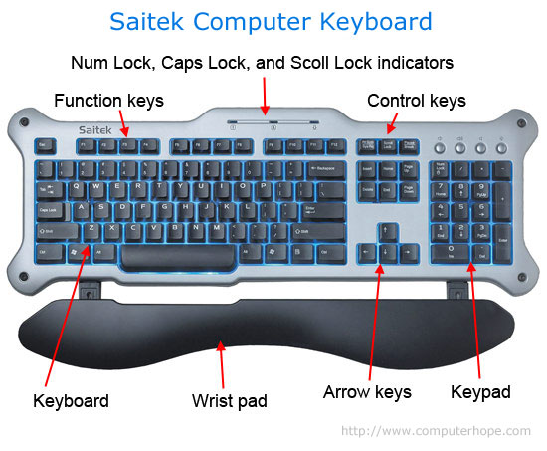
Computer Fundamentals: Pradeep K. Sinha & Priti Sinha
The Layout of Keys on a QW ERTY Keyboard
149

Slide 9
Computer Fundamentals: Pradeep K. Sinha & Priti Sinha
Point - and- Draw Devices
§ Used to rapidly point to and select a graphic icon or menu item from multiple options displayed on the Graphical User I nterface ( GUI) of a screen
§ Used to create graphic elements on the screen such as lines, curves, and freehand shapes
§ Some commonly used point-and-draw devices are mouse, track ball, joy stick, light pen, and touch screen
149

Slide 10
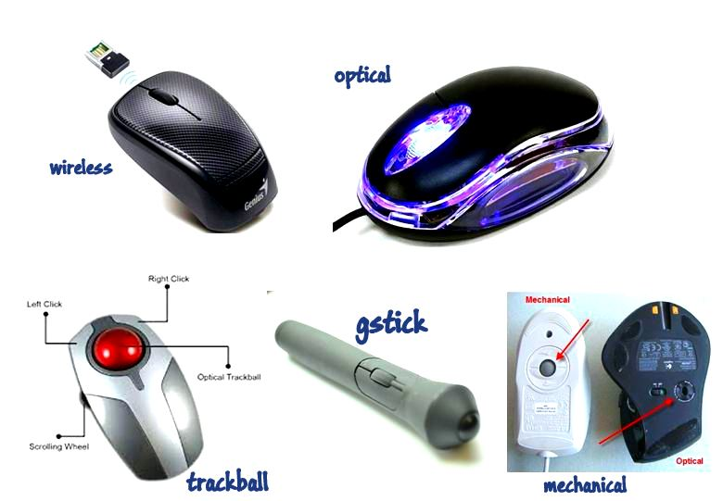
Mouse
Computer Fundamentals: Pradeep K. Sinha & Priti Sinha
Commonly used in personal computers and workstations
150

Slide 11
Elect ronic Pen
Computer Fundamentals: Pradeep K. Sinha & Priti Sinha
§ Pen-based point-and-draw device
§ Used to directly point with it on the screen to select menu items or icons or directly draw graphics on the screen
§ Can write with it on a special pad for direct input of written information to a system
§ Pressure on tip of a side button is used to cause same action as r ight- button- click of a mouse
152

Slide 12
Computer Fundamentals: Pradeep K. Sinha & Priti Sinha
Touch Screen
§ Most simple and easiest to learn of all input devices
§ Enables users to choose from available options by simply touching with their finger the desired icon or menu item displayed on the screen
§ Most preferred human-computer interface used in
information kiosks (unattended interactive information systems such as automatic teller machine or ATM)
152

Slide 13
Computer Fundamentals: Pradeep K. Sinha & Priti Sinha
Dat a Scanning Devices
§ Input devices that enable direct data entry into a computer system from source documents
§ Due to reduced human effort in data entry, they improve data accuracy and also increase the timeliness of the information processed
§ Demand high quality of input documents
§ Some data scanning devices are also capable of recognizing marks or characters
§ Form design and ink specification usually becomes more critical for accuracy
153

Slide 14
Computer Fundamentals: Pradeep K. Sinha & Priti Sinha
I m age Scanner
§ Input device that translates paper documents into an electronic format for storage in a computer
§ Electronic format of a scanned image is its bit map representation
§ Stored image can be altered or manipulated with an image-processing software
153

Slide 15
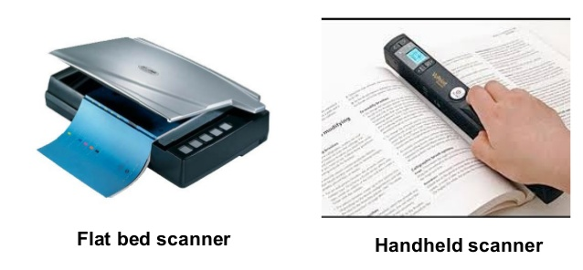
Computer Fundamentals: Pradeep K. Sinha & Priti Sinha
Tw o Com m on Types of I m age Scanners
153

Slide 16
Computer Fundamentals: Pradeep K. Sinha & Priti Sinha
Opt ical Charact er
Recognit ion ( OCR) Device
§ Scanner equipped with a character recognition software (called OCR software) that converts the bit map images of characters to equivalent ASCII codes
§ Enables word processing of input text and also requires less storage for storing the document as text rather than an image
§ OCR software is extremely complex because it is difficult to make a computer recognize an unlimited number of typefaces and fonts
§ Two standard OCR fonts are OCR-A (American standard) and OCR-B (European standard)
154

Slide 17
Computer Fundamentals: Pradeep K. Sinha & Priti Sinha
Opt ical Mark Reader ( OMR)
§ Scanner capable of recognizing a pre-specified type of mark by pencil or pen
§ Very useful for grading tests with objective type questions, or for any input data that is of a choice or selection nature
§ Technique used for recognition of marks involves focusing a light on the page being scanned and detecting the reflected light pattern from the marks
155

Slide 18
Computer Fundamentals: Pradeep K. Sinha & Priti Sinha
Sam ple Use of OMR
For each question, four options are given out of which only one is correct. Choose the correct option and m ark your choice against the corresponding question num ber in the given answer sheet by darkening the corresponding circle with a lead pencil.
1. The binary equivalent of decimal 4 is: a) 101
b) 111
c) 001
d) 100
The full form of CPU is:
Cursor Positioning Unit
Central Power Unit
Central Processing Unit
None of the above
Which is the largest unit of storage among the following:
Terabyte
Kilobyte
Megabyte
Gigabyte
Indicates direction in which the sheet should be fed to the OMR
1.
a
b
c
d
2.
a
b
c
d
3.
a b c d
(b) Pre-printed answer sheet
(a) Question sheet
A sample use of OMR for grading tests with objective type questions
155

Slide 19
Computer Fundamentals: Pradeep K. Sinha & Priti Sinha
Bar- code Reader
§ Scanner used for reading (decoding) bar-coded data
§ Bar codes represent alphanumeric data by a combination of adjacent vertical lines (bars) by varying their width and the spacing between them
§ Scanner uses laser-beam to stroke across pattern of bar code. Different patterns of bars reflect the beam in different ways sensed by a light-sensitive detector
§ Universal Product Code (UPC) is the most widely known bar coding system
155

Slide 20
Computer Fundamentals: Pradeep K. Sinha & Priti Sinha
An Exam ple of UPC Bar Code
Product category character 0 – grocery products
3 – drugs and health related products, etc.
0
21000
67520
Manufacturer/supplier identification number
Specific product code number
156

Slide 21
Computer Fundamentals: Pradeep K. Sinha & Priti Sinha
Magnet ic- I nk Charact er Recognit ion ( MI CR)
§ MICR is used by banking industry for faster processing of large volume of cheques
§ Bank’s identification code (name, branch, etc.), account number and cheque number are pre-printed (encoded) using characters from a special character set on all cheques
§ Special ink is used that contains magnetizable particles of iron oxide
§ MICR reader-sorter reads data on cheques and sorts them for distribution to other banks or for further processing
156

Slide 22
Computer Fundamentals: Pradeep K. Sinha & Priti Sinha
MI CR Character Set ( E1 3 B Font )
§ It consists of numerals 0 to 9 and four special characters
§ MICR is not adopted by other industries because it supports only 14 symbols
157

Slide 23
Digit izer
Computer Fundamentals: Pradeep K. Sinha & Priti Sinha
§ Input device used for converting (digitizing) pictures, maps and drawings into digital form for storage in computers
§ Commonly used in the area of Computer Aided Design (CAD) by architects and engineers to design cars, buildings medical devices, robots, mechanical parts, etc.
§ Used in the area of Geographical Information System (GIS) for digitizing maps available in paper form
157

Slide 24
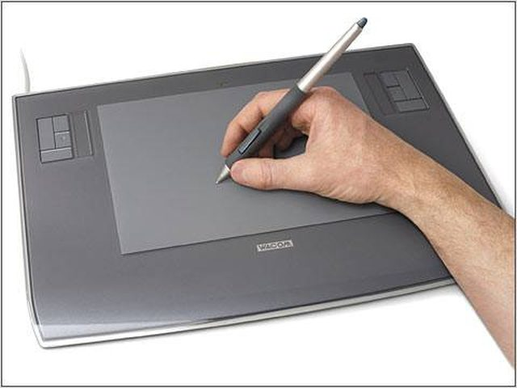
A Digit izer
Computer Fundamentals: Pradeep K. Sinha & Priti Sinha
Digitizing tablet
Stylus in the form of cross-hair cursor
Table top
158

Slide 25
Computer Fundamentals: Pradeep K. Sinha & Priti Sinha
Elect ronic- card Reader
§ Electronic cards are small plastic cards having encoded data appropriate for the application for which they are used
§ Electronic-card reader (normally connected to a computer) is used to read data encoded on an electronic card and transfer it to the computer for further processing
§ Used together as a means of direct data entry into a computer system
§ Used by banks for use in automatic teller machines (ATMs) and by organizations for controlling access of employees to physically secured areas
158

Slide 26
Computer Fundamentals: Pradeep K. Sinha & Priti Sinha
Speech Recognit ion Devices
§ Input device that allows a person to input data to a computer system by speaking to it
§ Today’s speech recognition systems are limited to accepting few words within a relatively small domain and can be used to enter only limited kinds and quantities of data
158

Slide 27
Computer Fundamentals: Pradeep K. Sinha & Priti Sinha
Types of Speech Recognit ion Syst em s
( Continued from previous slide..)
§ Single word recognition systems can recognize only a single spoken words, such as YES, NO, MOVE, STOP, at a time. Speaker-independent systems are mostly of this type
§ Continuous speech recognition systems can recognize spoken sentences, such as MOVE TO THE NEXT BLOCK. Such systems are normally speaker- dependent
158

Slide 28
Computer Fundamentals: Pradeep K. Sinha & Priti Sinha
Uses of Speech Recognit ion Syst em s
§ For inputting data to a computer system by a person in situations where his/her hands are busy, or his/her eyes must be fixed on a measuring instrument or some other object
§ For data input by dictation of long text or passage for later editing and review
§ For authentication of a user by a computer system based on voice input
§ For limited use of computers by individuals with physical disabilities
159

Slide 29
Computer Fundamentals: Pradeep K. Sinha & Priti Sinha
Vision- I nput Syst em s
§ Allow computer to accept input just by seeing an object.
§ Input data is normally an object’s shape and features in the form of an image
§ Mainly used today in factories for designing industrial robots that are used for quality-control and assembly processes
159

Slide 30
Computer Fundamentals: Pradeep K. Sinha & Priti Sinha
Com m only Used Out put Devices
§ Monitors
§ Printers (1/2 Self Read)
§ Plotters
§ Screen image projector
§ Voice response systems (Self Read)
160

Slide 31
Computer Fundamentals: Pradeep K. Sinha & Priti Sinha
Types of Out put
§ Soft- copy output
§ Not produced on a paper or some material and also can't be touched or carried for being shown to others
§ Temporary in nature and vanish after use
§ Examples are output displayed on a terminal screen or spoken out by a voice response system
§ Hard- copy output
§ Produced on a paper or some material that can be touched and carried for being shown to others
§ Permanent in nature and can be kept in paper files or can be looked at a later time when the person is not using the computer
§ Examples are output produced by printers or plotters on paper
160

Slide 32
Monit ors
Computer Fundamentals: Pradeep K. Sinha & Priti Sinha
§ Monitors are the most popular output devices used for producing soft-copy output
§ Display the output on a television like screen
§ Monitor associated with a keyboard is called a video display terminal (VDT). It is the most popular I/O device
160

Slide 33
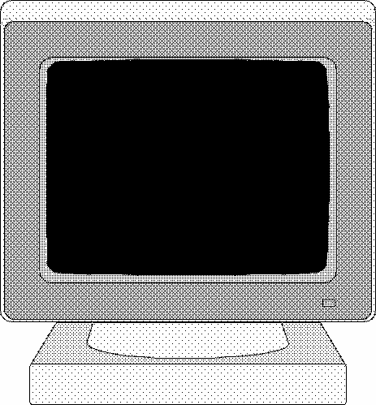
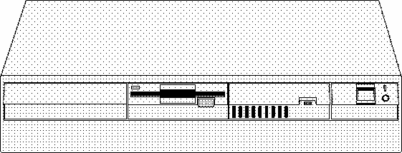


Monit ors
Computer Fundamentals: Pradeep K. Sinha & Priti Sinha
Monitor
Keyboard
A video display terminal consists of a monitor and a keyboard
160

Slide 34
Computer Fundamentals: Pradeep K. Sinha & Priti Sinha
Types of Monit ors
§ Cathode-ray-tube (CRT) monitors look like a television and are normally used with non-portable computer systems
§ Flat-panel monitors are thinner and lighter and are commonly used with portable computer systems like notebook computers. Now they are also used with non- portable desktop computer systems because they occupy less table space.
160

Slide 35
Pr int ers
Computer Fundamentals: Pradeep K. Sinha & Priti Sinha
Most
common
output
devices
for producing
hard-copy
output
160

Slide 36
Computer Fundamentals: Pradeep K. Sinha & Priti Sinha
Dot - Mat r ix Pr int ers
§ Character printers that form characters and all kinds of images as a pattern of dots
§ Print many special characters, different sizes of print and graphics such as charts and graphs
§ Impact printers can be used for generating multiple copies by using carbon paper or its equivalent
§ Slow, with speeds usually ranging between 30 to 600 characters per second
§ Cheap in both initial cost and cost of operation
161

Slide 37
Computer Fundamentals: Pradeep K. Sinha & Priti Sinha
Form at ion of Charact ers as a pat t ern of dot s
ABCDEFGHIJKLMNO PQRSTUVWXYZ 0123456789-.,
&/$*#%@=(+)
161

Slide 38
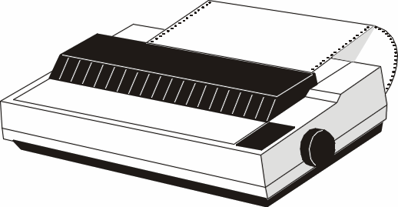
Computer Fundamentals: Pradeep K. Sinha & Priti Sinha
A Dot Mat r ix Pr int er
161

Slide 39
Computer Fundamentals: Pradeep K. Sinha & Priti Sinha
I nkj et Pr int ers
§ Character printers that form characters and all kinds of images by spraying small drops of ink on to the paper
§ Print head contains up to 64 tiny nozzles that can be selectively heated up in a few micro seconds by an integrated circuit register
§ To print a character, the printer selectively heats the appropriate set of nozzles as the print head moves horizontally
§ Can print many special characters, different sizes of print, and graphics such as charts and graphs
(Continued on next slide)
161

Slide 40
Computer Fundamentals: Pradeep K. Sinha & Priti Sinha
I nkj et Pr int ers
( Continued from previous slide..)
§ Non-impact printers. Hence, they cannot produce multiple copies of a document in a single printing
§ Can be both monochrome and color
§ Slower than dot-matrix printers with speeds usually ranging between 40 to 300 characters per second
§ More expensive than a dot-matrix printer
162

Slide 41
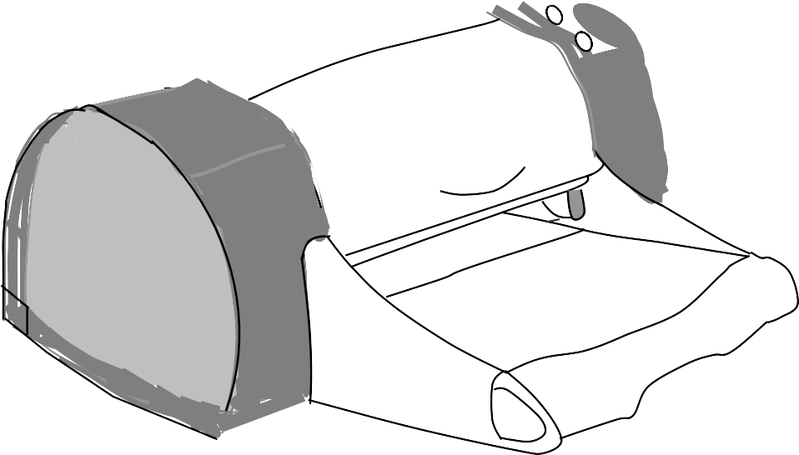
Computer Fundamentals: Pradeep K. Sinha & Priti Sinha
An I nkj et Pr int ers
162

Slide 42
Computer Fundamentals: Pradeep K. Sinha & Priti Sinha
Drum Pr int ers
§ Line printers that print one line at a time
§ Have a solid cylindrical drum with characters embossed on its surface in the form of circular bands
§ Set of hammers mounted in front of the drum in such a manner that an inked ribbon and paper can be placed between the hammers and the drum
§ Can only print a pre-defined set of characters in a pre- defined style that is embossed on the drum
§ Impact printers and usually monochrome
§ Typical speeds are in the range of 300 to 2000 lines per minute
162

Slide 43
Computer Fundamentals: Pradeep K. Sinha & Priti Sinha
Pr int ing Mechanism of a Drum Pr int er
Hammers (one for each band)
Paper
Ribbon
W W W W W W W W W W W W W W V V V V V V V V V V V V V V U U U U U U U U U U U U U U
Solid cylindrical drum with embossed characters
T T T T T T S S S S S S R R R R R R
T T T T T T T T S S S S S S S S R R R R R R R R
Q Q Q Q Q Q Q Q Q Q Q Q Q Q
P P P P P P P P P P P P P P O O O O O O O O O O O O O O
N N N N N N N N N N N N N N
Total number of bands is equal to the maximum number of characters (print positions) on a line
163

Slide 44
Computer Fundamentals: Pradeep K. Sinha & Priti Sinha
Chain/ Band Pr int ers
§ Line printers that print one line at a time
§ Consist of a metallic chain/band on which all characters of the character set supported by the printer are embossed
§ Also have a set of hammers mounted in front of the chain/band in such a manner that an inked ribbon and paper can be placed between the hammers and the chain/band
163

Slide 45
Computer Fundamentals: Pradeep K. Sinha & Priti Sinha
Chain/ Band Pr int ers
§ Can only print pre-defined sets of characters that are embossed on the chain/band used with the printer
§ Cannot print any shape of characters, different sizes of print, and graphics such as charts and graphs
§ Are impact printers and can be used for generating multiple copies by using carbon paper or its equivalent
§ Are usually monochrome
§ Typical speeds are in the range of 400 to 3000 lines per minute
164

Slide 46
Computer Fundamentals: Pradeep K. Sinha & Priti Sinha
Laser Pr int ers
§ Page printers that print one page at a time
§ Consist of a laser beam source, a multi-sided mirror, a photoconductive drum and toner (tiny particles of oppositely charged ink)
§ To print a page, the laser beam is focused on the electro statically charged drum by the spinning multi-sided mirror
§ Toner sticks to the drum in the places the laser beam has charged the drum’s surface.
§ Toner is then permanently fused on the paper with heat and pressure to generate the printer output
§ Laser printers produce very high quality output having resolutions in the range of 600 to 1200 dpi
(Continued on next slide)
164

Slide 47
Computer Fundamentals: Pradeep K. Sinha & Priti Sinha
Laser Pr int ers
( Continued from previous slide..)
§ Can print many special characters, different sizes of print, and graphics such as charts and graphs
§ Are non-impact printers
§ Most laser printers are monochrome, but color laser printers are also available
§ Low speed laser printers can print 4 to 12 pages per minute. Very high-speed laser printers can print 500 to 1000 pages per minute
§ More expensive than other printers
165

Slide 48
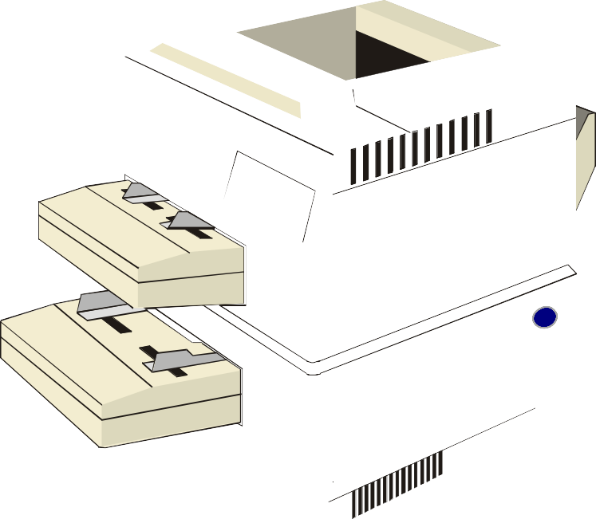

Computer Fundamentals: Pradeep K. Sinha & Priti Sinha
A Laser Pr int ers
164

Slide 49
Plot t ers
Computer Fundamentals: Pradeep K. Sinha & Priti Sinha
§ Plotters are an ideal output device for architects, engineers, city planners, and others who need to routinely generate high-precision, hard-copy graphic output of widely varying sizes
§ Two commonly used types of plotters are:
Drum plotter , in which the paper on which the design has to be made is placed over a drum that can rotate in both clockwise and anti-clockwise directions
Flatbed plotter, in which the paper on which the design has to be made is spread and fixed over a rectangular flatbed table
165

Slide 50
Computer Fundamentals: Pradeep K. Sinha & Priti Sinha
A Drum Plot t er
Paper
Design drawn on the paper
166

Slide 51
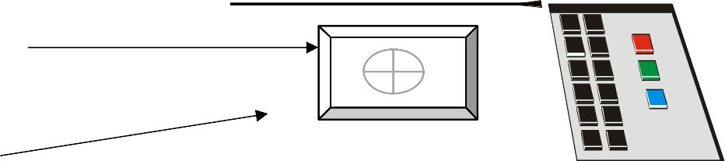
Computer Fundamentals: Pradeep K. Sinha & Priti Sinha
A Flat bed Plot t er
Design drawn on the paper
Paper
166

Slide 52
Computer Fundamentals: Pradeep K. Sinha & Priti Sinha
Screen I m age Proj ect or
§ An output device that can be directly plugged to a computer system for projecting information from a computer on to a large screen
§ Useful for making presentations to a group of people with direct use of a computer
§ Full-fledged multimedia presentation with audio, video, image, and animation can be prepared and made using this facility
166

Slide 53
Computer Fundamentals: Pradeep K. Sinha & Priti Sinha
Voice Response Syst em s
§ Voice response system enables a computer to talk to a user
§ Has an audio-response device that produces audio output
§ Such systems are of two types:
§ Voice reproduction systems
§ Speech synthesizers
(Continued on next slide)
167

Slide 54
Computer Fundamentals: Pradeep K. Sinha & Priti Sinha
Voice Reproduct ion Syst em s
( Continued from previous slide..)
§ Produce audio output by selecting an appropriate audio output from a set of pre-recorded audio responses
§ Applications include audio help for guiding how to operate a system, automatic answering machines, video games, etc.
167

Slide 55
Computer Fundamentals: Pradeep K. Sinha & Priti Sinha
Speech Synt hesizers
§ Converts text information into spoken sentences
§ Used for applications such as:
§ Reading out text information to blind persons
§ Allowing those persons who cannot speak to communicate effectively
§ Translating an entered text into spoken words in a selected language
168

